Slide 1
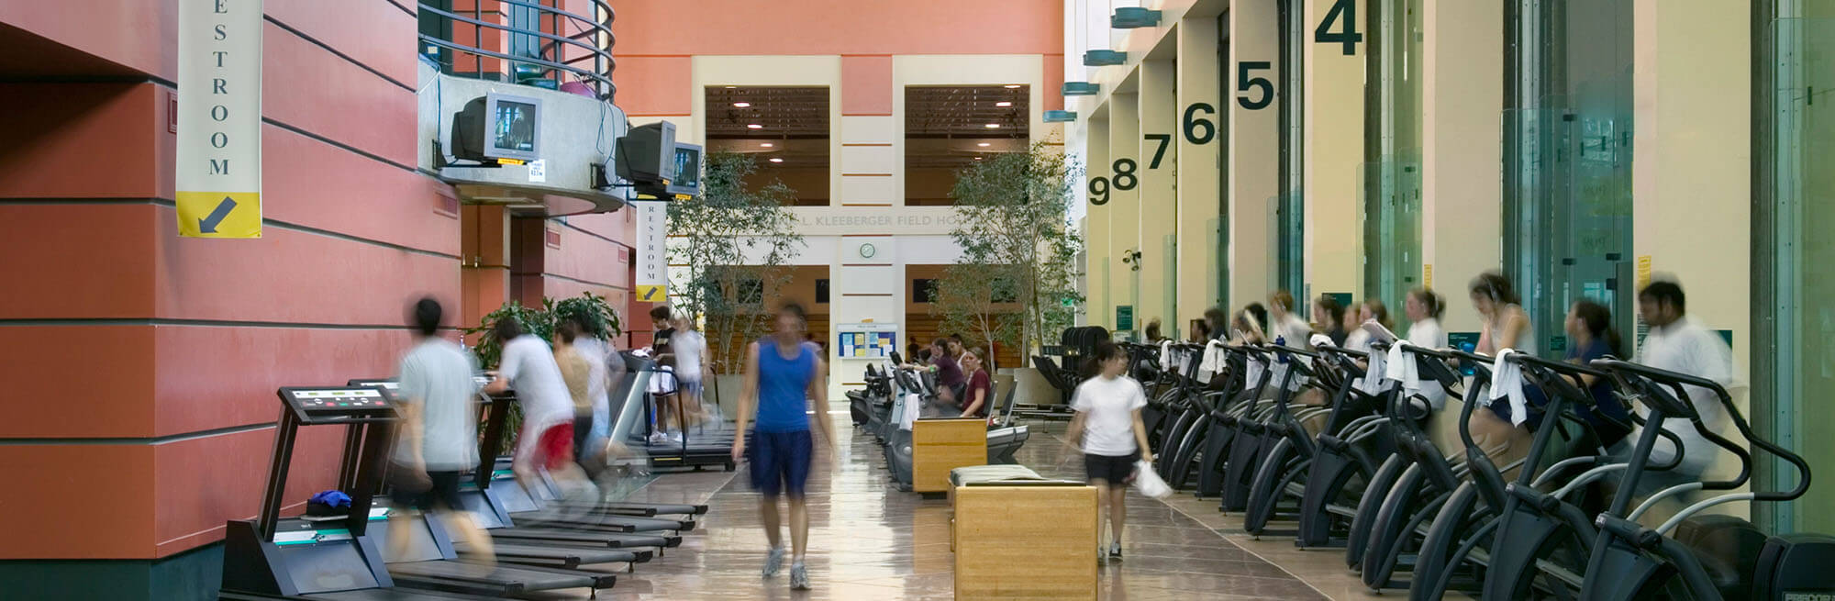
How Many People Are in the Gym?
Jeff Ernst
April 2017

Slide 2

UC Berkeley
Gym Attendance
Analysis
Jeff Ernst
April 2017

Slide 3
Analysis Goals

Slide 4





Data Overview
Predictors
Target
School
Holiday
Climate
Date / Time
Gym Attendance
Semester #
Major Holiday
Temperature
Day of Week
During Semester
Precipitation
Hour
Holiday Recess
Start of Semester
Academic Holiday
Week of Semester

Slide 5
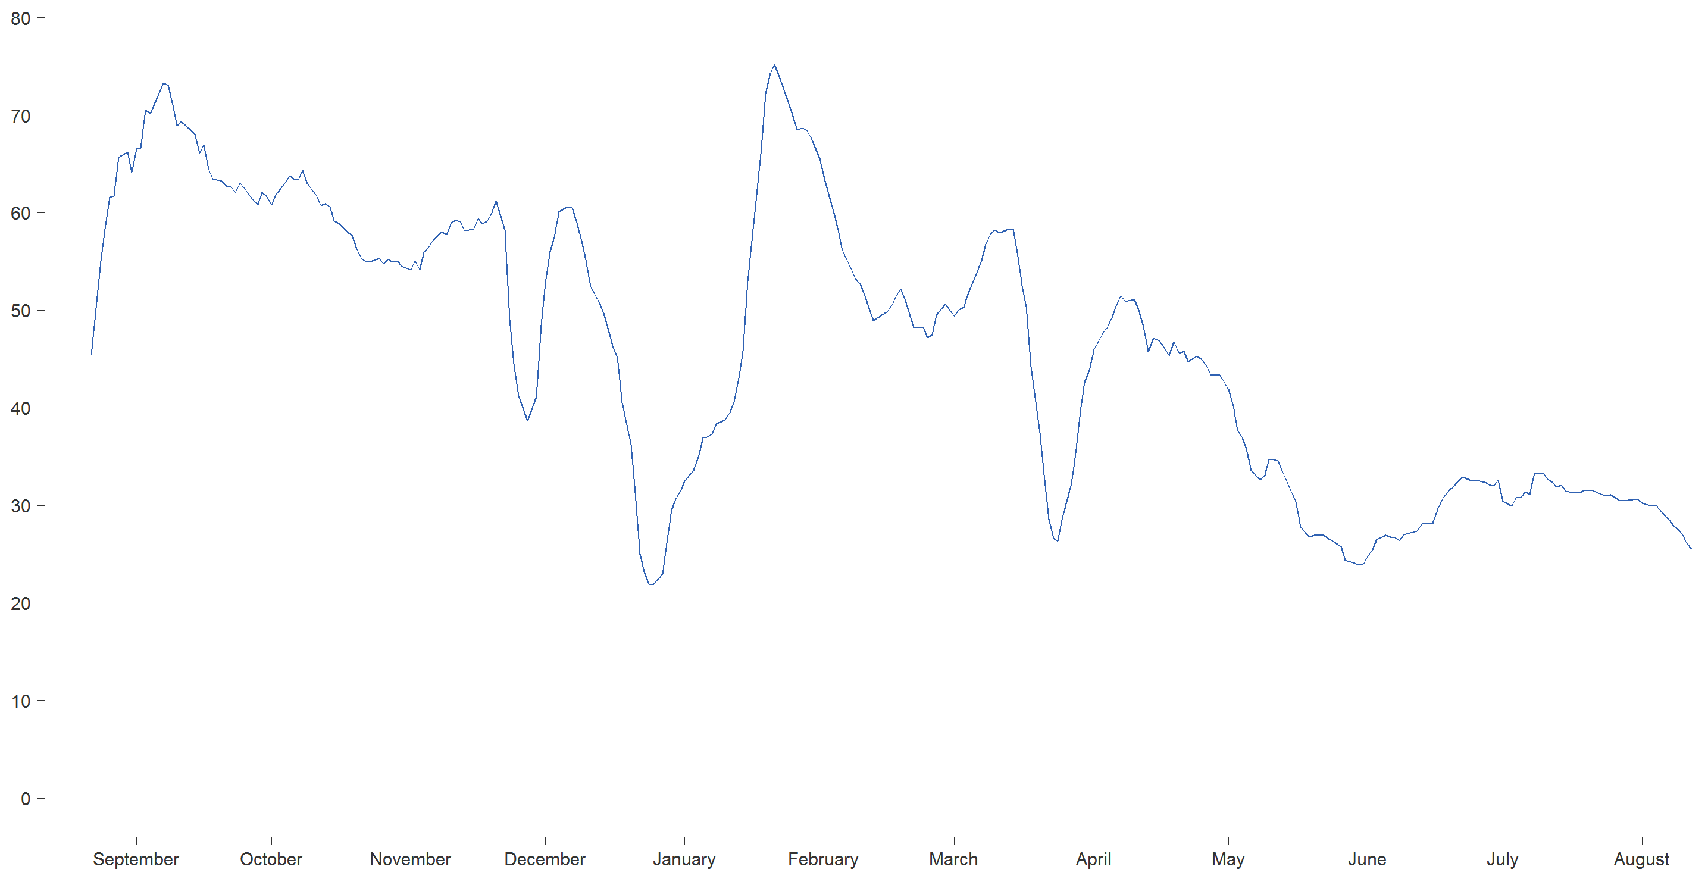
UC Berkeley 2015-16 Gym Attendance
Number of People
(7-day Moving Average)
Month

Slide 6
UC Berkeley 2015-16 Gym Attendance
School Begins
Aug 26, 2016
Every freshman is in the gym until next week
Number of People
(7-day Moving Average)
Month

Slide 7
UC Berkeley 2015-16 Gym Attendance
School Begins
Aug 26, 2016
Every freshman is in the gym until next week
Number of People
(7-day Moving Average)
Thanksgiving
Nov 26 2015
Working out is optional when you’re filling up on turkey and mashed potatoes
Month

Slide 8
UC Berkeley 2015-16 Gym Attendance
School Begins
Aug 26, 2016
Every freshman is in the gym until next week
Number of People
(7-day Moving Average)
Thanksgiving
Nov 26 2015
Working out is optional when you’re filling up on turkey and mashed potatoes
Winter Break
Dec 19-Jan 19, 2015
Most students head home for the winter holidays, like Christmas and Hanukkah
Month

Slide 9
UC Berkeley 2015-16 Gym Attendance
School Begins
Aug 26, 2016
Every freshman is in the gym until next week
New Year’s Gym Rush
Jan 20, 2016
Students flood to the gym in a futile attempt to fulfill their New Year’s goals
Number of People
(7-day Moving Average)
Thanksgiving
Nov 26 2015
Working out is optional when you’re filling up on turkey and mashed potatoes
Winter Break
Dec 19-Jan 19, 2015
Most students head home for the winter holidays, like Christmas and Hanukkah
Month

Slide 10
UC Berkeley 2015-16 Gym Attendance
School Begins
Aug 26, 2016
Every freshman is in the gym until next week
New Year’s Gym Rush
Jan 20, 2016
Students flood to the gym in a futile attempt to fulfill their New Year’s goals
Number of People
(7-day Moving Average)
Thanksgiving
Nov 26 2015
Working out is optional when you’re filling up on turkey and mashed potatoes
Winter Break
Dec 19-Jan 19, 2015
Most students head home for the winter holidays, like Christmas and Hanukkah
Spring Break
Mar 21-25, 2016
Spring break! Party! Woo!
Month

Slide 11
UC Berkeley 2015-16 Gym Attendance
School Begins
Aug 26, 2016
Every freshman is in the gym until next week
New Year’s Gym Rush
Jan 20, 2016
Students flood to the gym in a futile attempt to fulfill their New Year’s goals
Number of People
(7-day Moving Average)
Spring Commencement
May 14, 2016
The gym becomes an empty wasteland until next year
Thanksgiving
Nov 26 2015
Working out is optional when you’re filling up on turkey and mashed potatoes
Winter Break
Dec 19-Jan 19, 2015
Most students head home for the winter holidays
Spring Break
Mar 21-25, 2016
Spring break! Party! Woo!
Month

Slide 12
UC Berkeley 2015-16 Gym Attendance
School Begins
Aug 26, 2015
Every freshman is in the gym until next week
New Year’s Gym Rush
Jan 20, 2016
Students flood to the gym in a futile attempt to fulfill their New Year’s goals
Number of People
(7-day Moving Average)
Spring Commencement
May 14, 2016
The gym becomes an empty wasteland until next year
Thanksgiving
Nov 26 2015
Working out is optional when you’re filling up on turkey and mashed potatoes
Winter Break
Dec 19-Jan 19, 2015
Most students head home for the winter holidays
Spring Break
Mar 21-25, 2016
Spring break! Party! Woo!
Month

